Slide 1
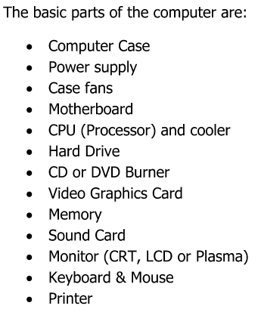
Hardware

Slide 2
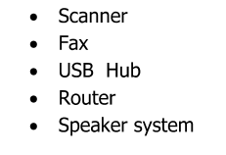
Optional parts

Slide 3

Computer Cases

Slide 4
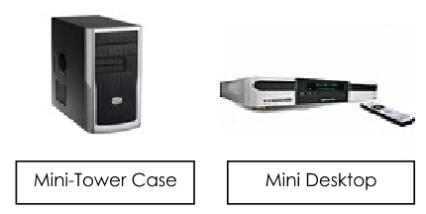
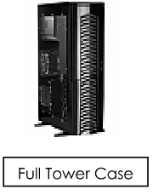
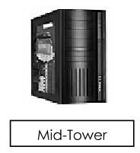
Computer Cases

Slide 5


Other Components

Slide 6
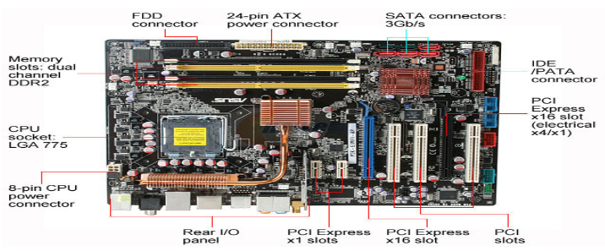
Intel Mother Board

Slide 7
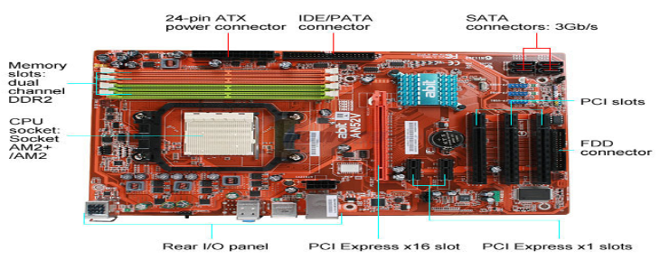
AMD Motherboard

Slide 8
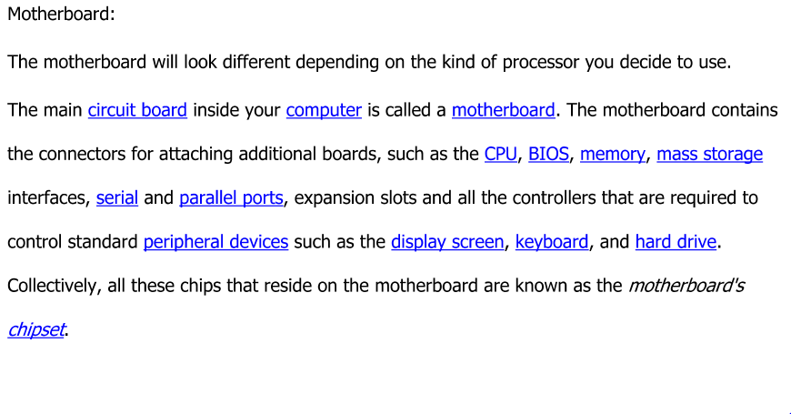
Contents of the Motherboard

Slide 9

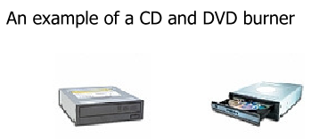
Peripheral Devices

Slide 10

Types of Monitors

Slide 11
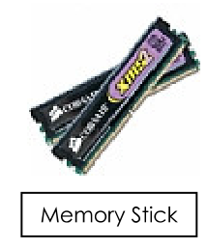
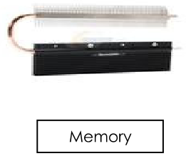
Memory

Slide 12
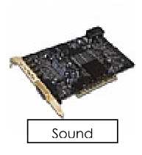

Sound Card and Speaker System

Slide 13

Input Devices

Slide 14

Types of Printers

Slide 15


Accessories

Slide 16

Other Accessories

Slide 17
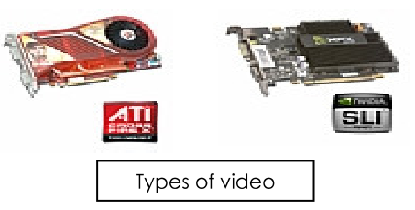

Slide 18

Computer Operating Systems

Slide 19

Functions of an Operating System

Slide 20

Primary Functions

Slide 21
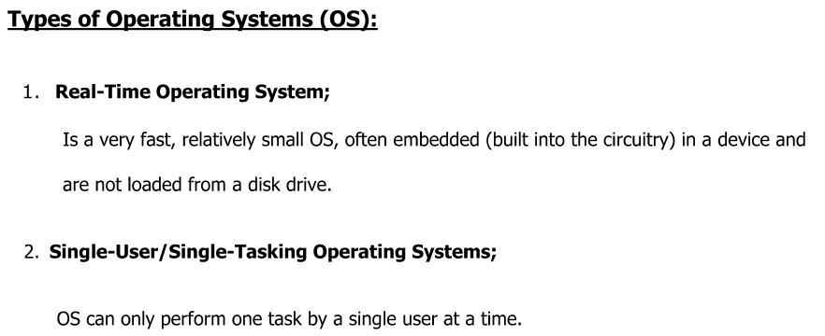

Slide 22
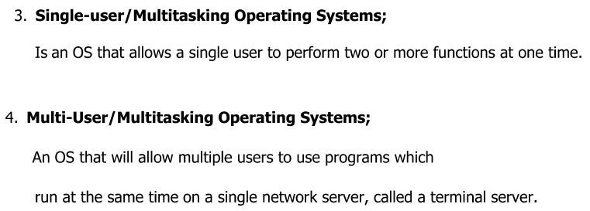
Types of OS (cont’d)

Slide 23
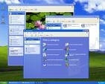
Some Common Operating Systems

Slide 24


Some Common Operating Systems

Slide 25


Some Common Operating Systems

Slide 26
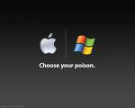
Some Common Operating Systems

